Slide 1

Healthcare Chatbot For Home Remedies
This presentation outlines the development of a Health chatbot designed to provide health solutions for common daily life ailments.

Slide 2

Problem Statement
Many people seek quick and effective solutions for common health issues at home. However, finding reliable information can be time-consuming and confusing. A home remedies chatbot can provide instant access to accurate and trustworthy information, empowering users to self-care effectively.
Health Issues
Solution Gap
Need
Common health problems like colds and coughs are often not addressed effectively.
Many people rely on general advice, but traditional trust worthy solutions are lacking.
A system providing reliable home remedies.

Slide 3
Literature Survey
An NLP Chatbot on Home Remedies for Common Diseases
Proposed Solution
Development of a chatbot using NLP techniques (TF-IDF and cosine similarity) to understand user queries and deliver relevant home remedies from a predefined dataset. Built with Python and Flask for easy access via a web interface.
Features
Fast and cost-effective health support
Easy to understand and lightweight NLP methods
High performance: Precision – 85.71%, Recall – 100%, F1-score – 92.3%
Drawbacks
No deep understanding of user context due to lack of advanced semantic models.

Slide 4
Disease_Detection_Using_RASA_Chatbot.pdf
This paper discusses the development of a healthcare chatbot using the RASA framework and machine learning for disease detection.
Technical Implementation
Framework: RASA is used for Natural Language Processing (NLP) and conversational AI.
Machine Learning Models: Various classification algorithms were implemented for disease prediction.
Features
Symptom-Based Predictions: Provides predictions for potential diseases based on user symptoms.
Doctor Appointment Bookings: Facilitates scheduling medical consultations.
Results
The chatbot successfully demonstrated the ability to provide a convenient, accessible healthcare solution.
This approach combines RASA's conversational AI capabilities with machine learning for an efficient and user-friendly healthcare assistant.
Drawbacks
This paper just detects the health disease based on symptoms but doesn't provide home remedies for curation.

Slide 5
Home Remedies Recommender
recommender-system-for-home-remedy-IJERTV11IS040154.pdf
Objective: A website recommending home remedies for mild illnesses based on user symptoms.
Approach:
Utilized Machine Learning algorithms to suggest fruits and herbs.
Recommendations are based on symptom data, processed through machine learning models.
Key Insights:
Highlights the importance of personalized recommendations for health-related queries.
Naive Bayes provided the highest accuracy (79%-85%) for symptom classification​.
Drawback
In this paper they just recommend a fruit based on user health conditions but they doesn't provide traditional home remedies for curing it.

Slide 6
Other Resources
Introduction to Rasa Pro - Rasa Documentation
Building and Deploying a Chatbot from Scratch using Rasa Framework: A Complete Guide for Beginners
A step-by-step Guide for Developing a Chatbot for Healthcare Apps • QuickBlox
A Developer Guide for Creating a Multi-Modal Chatbot Using LangChain Agents

Slide 7
Proposed Solution
This project introduces a Home Remedies Chatbot aimed at promoting natural health solutions by providing generalized home remedies for common health issues.
The chatbot is developed using Rasa that takes user queries and respond with relevant home remedies. It employs embedding-based similarity techniques to accurately match user-described symptoms with appropriate remedies from a curated dataset.
To improve user engagement and accessibility, the chatbot supports voice feature.
For each health issue addressed, the bot not only suggests remedies but also provides external reference links for key ingredients, ensuring users can easily access or learn more about them.
A distinctive feature of the system is the feedback and suggestion module, which invites users to share their own knowledge of remedies. These inputs are stored in a secure admin dashboard, enabling the administrator to review, validate, and incorporate valuable user contributions into the training data—making the chatbot continuously improvable.
The bot further offers ingredient-specific information and suggests generalized daily health schedules that users can follow to manage or prevent the given health issue.
The system is designed to serve as a first-level, informative assistant for promoting wellness using traditional and natural practices.

Slide 8
Technology Stack
Operating System: Windows 10/11 or Ubuntu 20.04
Programming Language: Python 3.8
Frameworks & Libraries: The core technologies employed include Rasa (Core & NLU) for conversational AI, Hugging Face Transformers (e.g., T5/BERT) for advanced language understanding.
Frontend : React
Backend : Flask
APIs & Tools: For handling voice input, the Web Speech API will be utilized to convert spoken language into text. To securely store user feedback and suggested remedies, a database solution such as SQLite is implemented. We used Gemini API to generate generalized health related schedules.
IDE: VS Code

Slide 9
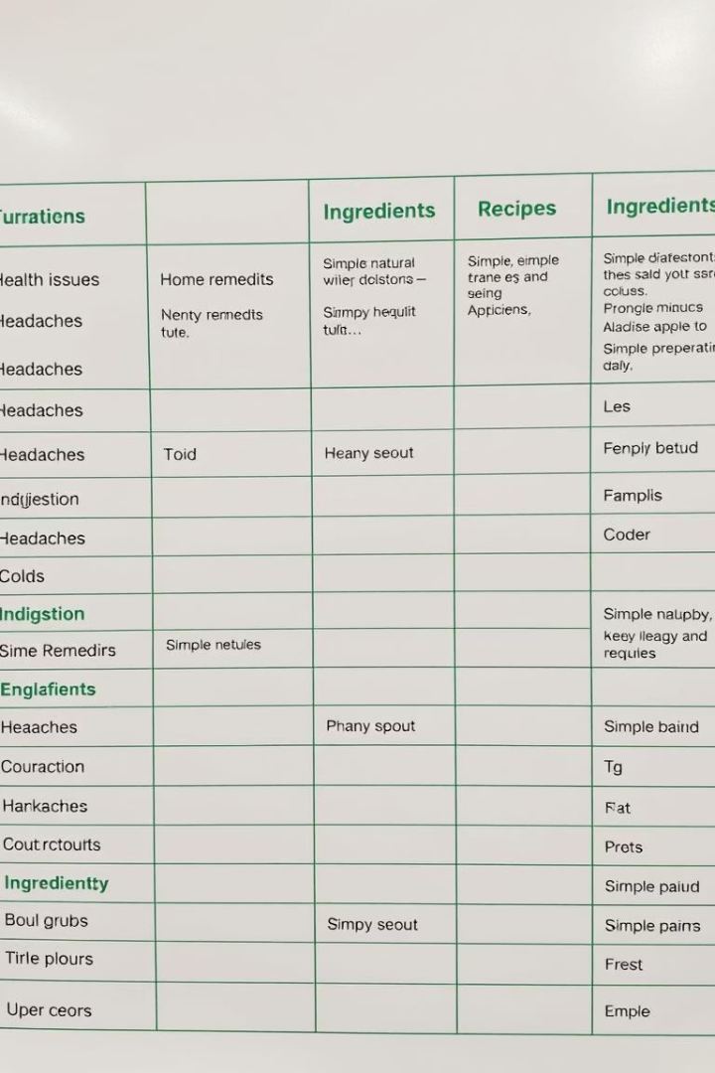
Dataset
Dataset
Kaggle Home Remedies Dataset
Content
Home remedies for various health issues
Features
Ingredients, recipes, traditional remedies, and health tips
ARTICLES:

Slide 10
Trusted Data Sources for Our Health Bot
1️⃣ Kaggle – A Reliable Source for Medical Datasets & AI Training
Home to a vast collection of health-related datasets, contributed by researchers and healthcare institutions.
Used to train AI models for diagnosing symptoms and recommending home remedies.
Datasets are reviewed by a large data science community, ensuring quality control.
2️⃣ WebMD – A Recognized Medical Information Platform
Provides medically reviewed content by doctors and healthcare professionals
Verified drug interactions, side effects, and self-care solutions.

Slide 11
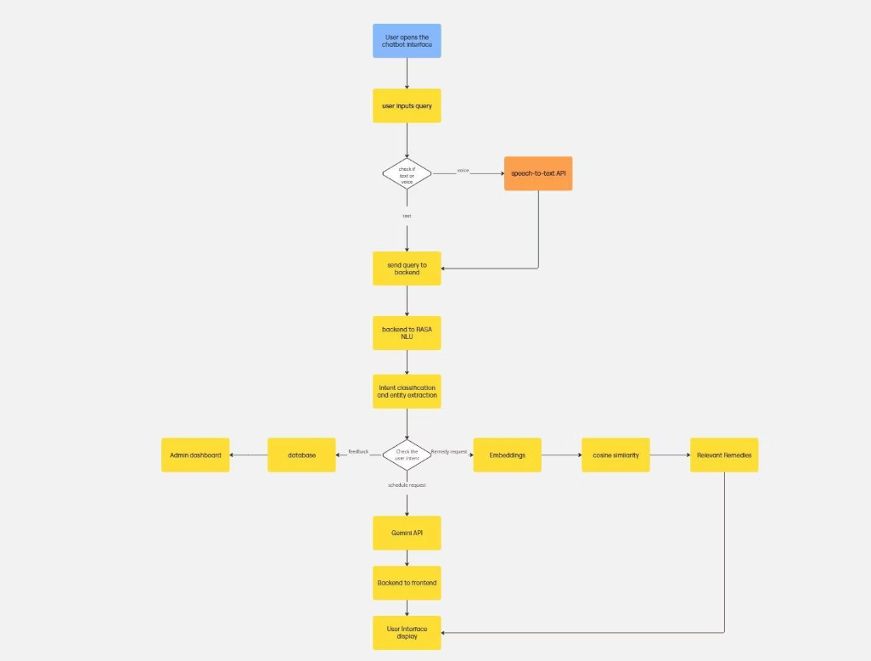
Process Flow

Slide 12
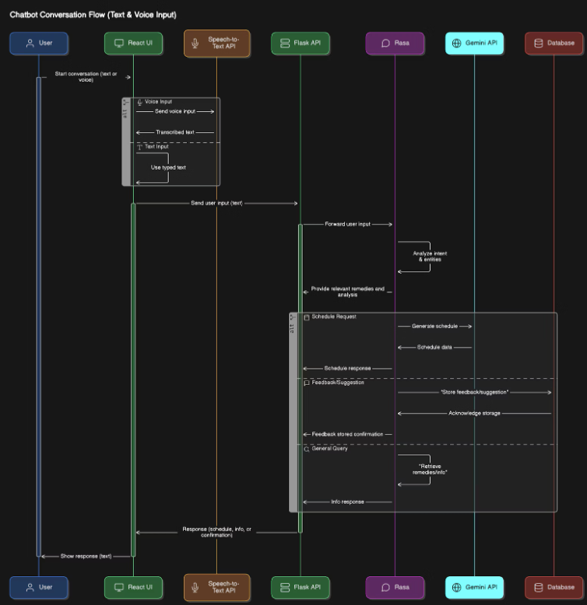
System Architecture

Slide 13
Available Technologies
Platforms for Chatbot Building:
Technology
Pros
Cons
Fit for Project
Rasa
Customizable, open-source, supports multi-input formats, integrates with backend, multilingual support.
Complex setup, requires significant training data.
Good
Dialogflow
Easy to use, integrates well with Google services (Firebase), multi-platform support, multilingual.
Limited customization, can be expensive at scale.
Good
Twilio Autopilot
Multi-channel, integrates with Twilio services, easy to use.
Limited customizability compared to Rasa or Hugging Face, pricing.
Moderate
Amazon Lex
Integration with AWS, speech-to-text capabilities, scalable.
Limited customizability, AWS-specific.
Moderate
LangChain
Orchestrates complex workflows, integrates LLMs with external APIs, flexible.
Requires programming expertise, more complex for beginners.
Good for advanced workflows
Conclusion:
Rasa is the best fit for your health chatbot project. It offers high flexibility, customization, and full control over model training, making it ideal for handling diverse user inputs and integrating with external APIs like GPT for schedule generation. Its robust NLU capabilities and open-source nature ensure scalability and cost-effectiveness. Rasa's seamless integration with your backend and ability to manage complex workflows make it the optimal choice for your project.

Slide 14
Rasa Introduction
Rasa NLU
Rasa Core
This component processes user messages, extracting intents (the user’s intention) and entities (specific pieces of information). It uses machine learning algorithms to understand natural language.
Responsible for managing the dialogue flow, it decides how the chatbot should respond based on the current conversation context. It uses policies to predict the next action the bot should take.
Rasa SDK
Rasa X
Allows customization of actions performed by the chatbot. Actions can include querying databases, calling APIs, or performing any other task required to fulfil user requests.
An interface for developers to improve and manage their chatbots. It facilitates data annotation, model training, and conversation exploration.

Slide 15
Steps to implement Rasa:
Setup: Install Rasa and initialize a new project using rasa init.
Prepare Dataset:
  Convert your tabular dataset into YAML format with intents, entities, and actions.
  Define intents such as health_issue_query, schedule_creation, etc., in the nlu.yml file.
  Rasa uses the DIET (Dual Intent and Entity Transformer) model by default for intent classification and entity recognition.
  The DIET model predicts the most likely intent based on training data.
  Use stories.yml to define conversation paths based on user inputs and bot responses.
  Add custom actions in actions.py to send notifications, request additional details, or interact with external APIs.
Train: Train the bot using rasa train. This generates a model capable of intent recognition and response generation.
Test: Use rasa shell or an HTTP API to test your bot.

Slide 16
Working of Rasa - DIET Classifier Model
Step 1: Text Embedding
User Input: User sends a message like "I have a headache and fever."
Tokenization:
The sentence is broken down into individual tokens (words):
→ "I", "have", "a", "headache", "and", "fever"
Embedding Conversion:
Each token is converted into a numerical vector (embedding) that captures its semantic meaning.
Example:
→ "fever" → [0.6, 0.2, ..., 0.9]

Slide 17
Step 2: Contextual Understanding Using Transformer
Input to Transformer:
The word embeddings from Step 1 are passed into a Transformer model used by the DIET classifier.
Self-Attention Mechanism:
The Transformer applies self-attention to understand the relationship between words in the sentence.
We’ll compute the attention score between two tokens using this formula:
Attention(Q,K,V)=softmax(QK^T/dk^(1/2))⋅V
Let’s keep it simple with just 2 tokens, and a small dimension size dk=2.
Sample Input:
We define the Query (Q), Key (K), and Value (V) vectors for two tokens (Assuming "Have" and "Headache" as two tokens):
Token
Q (Query)
K (Key)
V (Value)
Token 1
[1, 0]
[1, 0]
[0.5, 1.0]
Token 2
[0, 1]
[0, 1]
[1.5, 0.5]
1. Compute Dot Product Q .K^T
We compute the dot product between Token 1’s Query and all Keys:
Score(Token 1 vs Token 1) = [1, 0] .[1, 0]^T = 1
Score(Token 1 vs Token 2) = [1, 0]. [0, 1]^T = 0
So the score vector for Token 1 is: [1,0]

Slide 18
2. Scale by dk(^1/2)
Here, dk=2, so sqrt(2)≈1.41
Scaled scores = [1/1.41,0/1.41]≈[0.71,0]
Step 3: Apply Softmax
softmax([0.71,0]) = [e^0.71/(e^0.71+e^0),e^0/(e^0.71+e^0)]
Softmax = [2.03/(2.03+1),1/(2.03+1)]≈[0.67,0.33]
Step 4: Multiply by Value Vectors
Now compute the weighted sum of the Value vectors:
Attention Output=0.67⋅[0.5,1.0]+0.33⋅[1.5,0.5]
✅ Final contextual vector of token 1 = [0.83, 0.835]
The output is a context-rich representation of each token, ready for tasks like intent classification or entity extraction.

Slide 19
Step 3: Sentence Embedding
Once each token is enhanced with context using the Transformer layers, the model needs a single vector that summarizes the entire message—this is called the sequence embedding or sentence embedding.
This vector is generated by either averaging or pooling all the contextual token embeddings.
This single vector is a compressed, meaningful representation of the user’s full message, capturing what the user is trying to say and which words are important.
s=1/n​ ∑hi​ where 1<i<n
n is the number of tokens in the sentence,
hi​ is the contextual embedding of the ith token (after attention),
s is the final sentence vector.
Example: We have
h1=[0.83, 0.835]
h2=[1.17, 0.665]
Add them element-wise
[0.83+1.17,0.835+0.665]= [2.0,1.5]
Divide by the number of tokens (n = 2)
s= [2.0/2,1.5/2]= [1.0,0.75]

Slide 20
Step 4: Intent Classification
Use the Final Sentence Embedding
From earlier, we have:
Sentence embedding: s=[1.0,0.75]
Pass Through Linear Layer
The model uses:
Weight matrix Wi
Bias vector bi​
Let’s assume we have 3 intent classes:
["greet", "ask_symptom_remedy", "goodbye"]
We define:
Wi = [0.2 0.4, 0.7 0.1, 0.5 0.3], bi = [0.1,0.2,0.0]

Slide 21
Now compute:
z=Wi⋅s+bi
Matrix Multiplication
Wi⋅s = [0.2∗1.0+0.4∗0.75, 0.7∗1.0+0.1∗0.75, 0.5∗1.0+0.3∗0.75]= [0.2+0.3, 0.7+0.075, 0.5+0.225] = [0.5 0.775 0.725]
Add bias:
z = [0.5+0.1, 0.775+0.2, 0.725+0.0]=[0.6, 0.975, 0.725]
Apply SoftMax
softmax(zi)=e^zi/∑e^zj
Probabilities:
greet: 1.822/6.54≈0.278
ask_symptom_remedy: 2.653/6.54≈0.406
goodbye: 2.065/6.54≈0.316
Predicted Intent: ask_symptom_remedy (highest score = 0.406)

Slide 22
Step 5: Entity Extraction
While intent classification gives the overall meaning of the message,
entity extraction identifies important words (like symptoms, dates, etc.).
Token Embeddings from Transformer
Each word in the message has its own contextual embedding from the transformer:
Example tokens: "I", "have", "a", "headache", "and", "fever"
Corresponding embeddings: t1,t2,…,tn
Pass Through Entity Classifier
For each token embedding ti, we compute: y^entity=softmax(We⋅ti+be)
Output
This gives a probability distribution over entity labels like:
  SYMPTOM, DATE, LOCATION, O (no entity), etc.
The label with the highest score is chosen.

Slide 23
Step 6: Loss Calculation and Training
Separate Loss Functions
Intent Loss (L_intent): Measures how far the predicted intent is from the true one.
Entity Loss (L_entity): Measures how wrong the entity tags are for each token.
Both use cross-entropy loss, a standard loss for classification problems.
Combining the Losses
Rasa combines the two using this formula:
Ltotal=λ⋅Lintent+(1−λ)⋅Lentity
λ (lambda): a number between 0 and 1 that balances the two tasks.
  If λ = 0.7, then 70% importance is given to intent prediction, and 30% to entity extraction.
The model adjusts its weights to reduce this total loss.
Over time, this makes it better at:
Predicting the right intent
Recognizing the correct entities

Slide 24
Step 7: Paraphrasing the User Query
After the intent is identified and the system decides what action to take,
The original query q is passed into a paraphrasing model like T5 (Text-to-Text Transfer Transformer).
The model generates a new sentence q′ that has the same semantic meaning, but different wording.
🔤 Notation:
q′=Paraphrase(q)
q: Original user query
Example: “I have a headache and fever”
q′: Paraphrased query
Example: “I’m experiencing fever and a headache”

Slide 25
Step 8: Embedding the Paraphrased Query
The paraphrased query q′ is passed into an embedding model, such as gtr-t5-base
The model encodes the meaning of the entire sentence into a dense vector s.
Formula Representation:
s=Embed(q′)
q′: Paraphrased sentence (e.g., “I’m experiencing fever and a headache”)
s: Sentence embedding — a vector that captures the semantic meaning of the sentence.

Slide 26
Step 9: Computing Cosine Similarity
Now that you have the embeddings for both the user’s paraphrased query s and each remedy key ri embedded previously​, you need to compute the cosine similarity between them. Cosine similarity is used to measure the similarity between two vectors based on their direction, not their magnitude.
cosine_sim(s,ri)= s⋅ri / ∥s∥⋅∥ri∥
Where . is the dot product between the two vectors s and ri​, ∥s∥ and ∥ri∥ are the magnitudes (norms) of the vectors s and ri​, respectively.
Cosine similarity is ideal because it measures directional similarity regardless of vector magnitude.
It helps find how semantically similar the query is to the remedy without worrying about the length of the vectors.

Slide 27
Key Features
Voice Feature: We have used the Web Speech API to handle audio interactions, enabling both voice input from the user and voice responses from the system.
Ingredient Links: A curated dataset was created containing a list of ingredients along with their corresponding Wikipedia links. This dataset is used to extract ingredients from the remedies and provide informative links to the user.
Generalized Health Schedules: We utilized the Gemini API to generate personalized 7-day health schedules based on the user's reported health issues.
Feedback and Suggestions: Due to the limited size of our dataset, we encourage users to contribute suggestions for remedies. These suggestions are stored in the database and can be viewed on admin dashboard, allowing the admin to review, validate, and integrate them into the Rasa chatbot for future training.

Slide 28
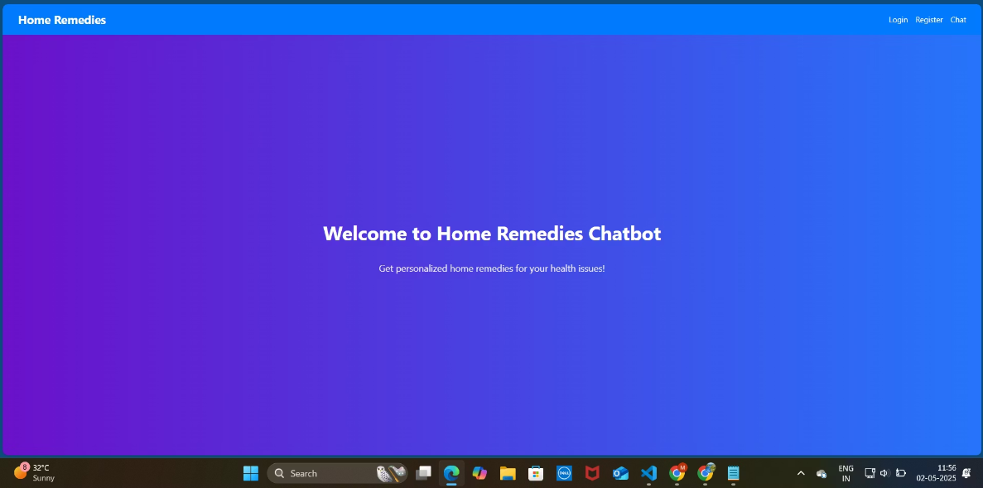
Results

Slide 29
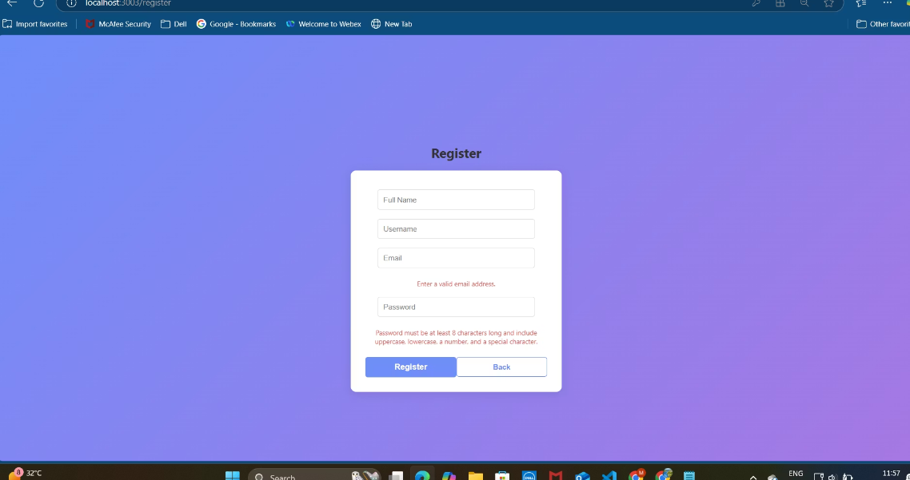

Slide 30
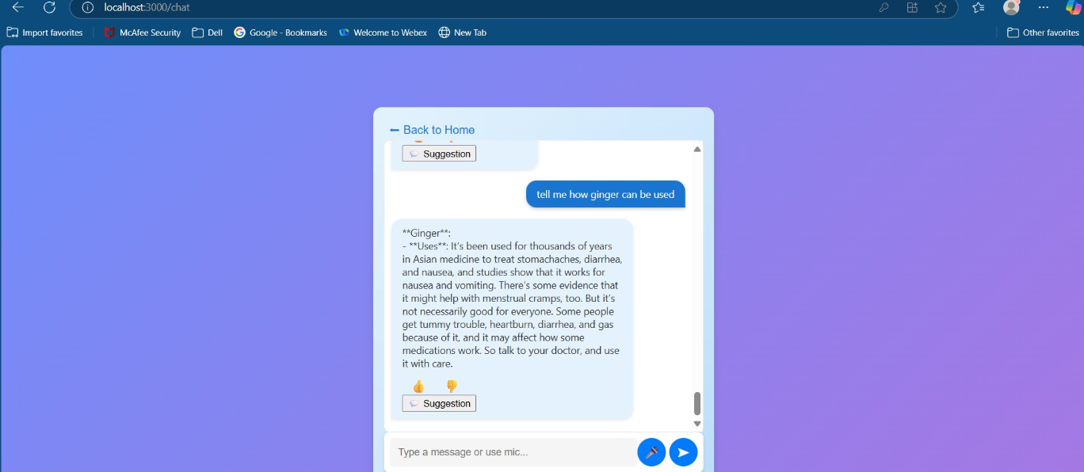

Slide 31
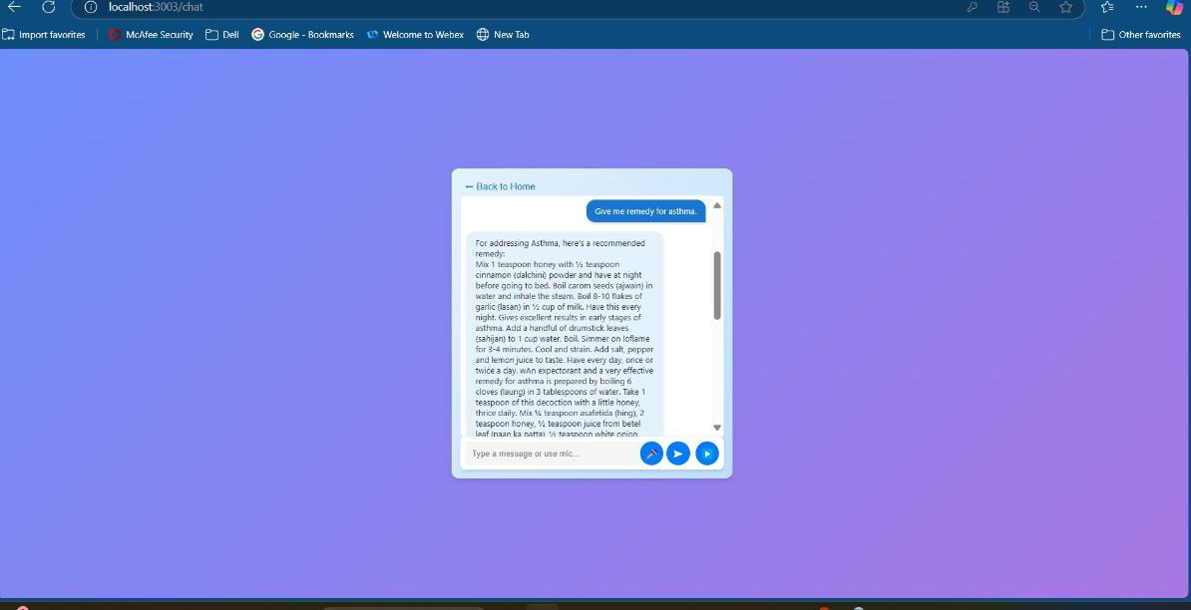

Slide 32
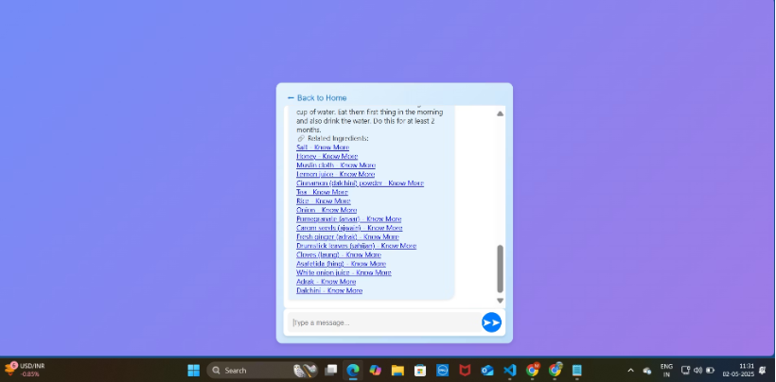
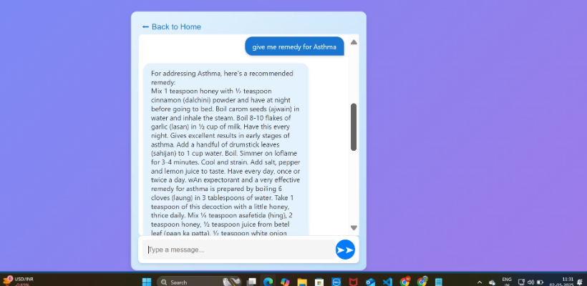

Slide 33
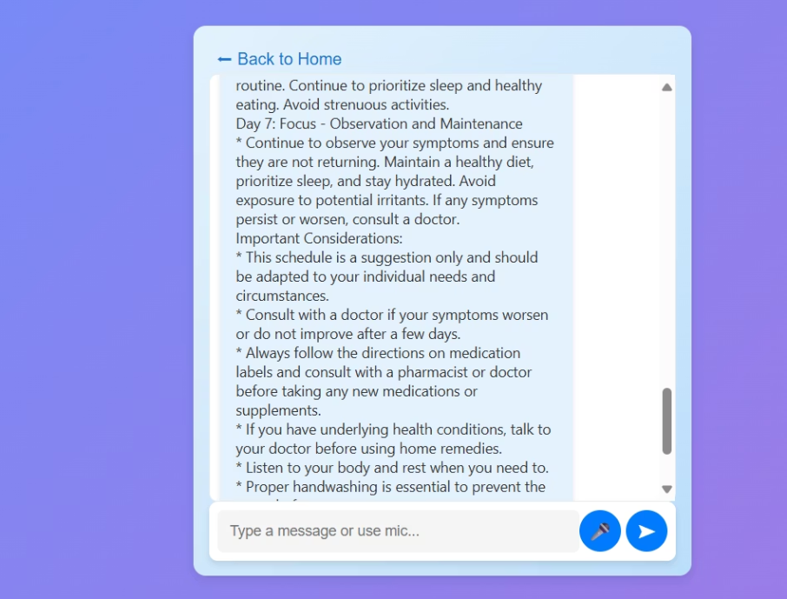

Slide 34
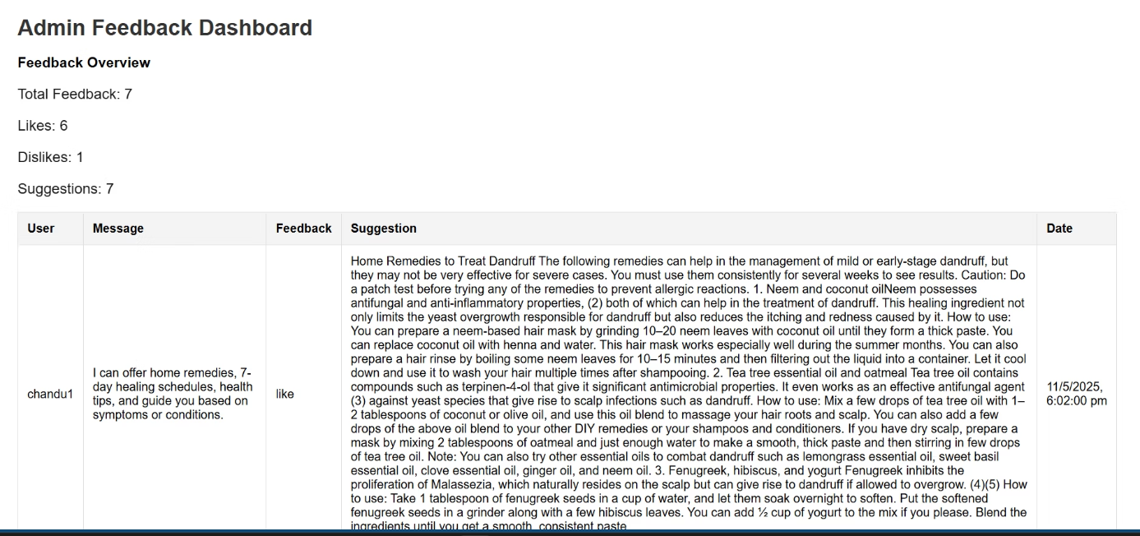

Slide 35
Evaluation Metrics
Metric Type
Precision
Recall
F1-Score
Support
Accuracy
Entity
1.0
1.0
1.0
39
1.0
Intent
0.9843
0.9839
0.9839
373
0.9839
Stories
1.0
1.0
0.945
36
0.914

Slide 36

Conclusion and Future Work
The Home Remedies Chatbot serves as a practical and user-friendly solution for individuals seeking natural remedies for common health concerns. By understanding user inputs in both text and voice formats, the chatbot delivers responses that align with traditional health practices. Its intelligent query handling ensures that user concerns are interpreted accurately, regardless of how they are phrased, and matches them with the most relevant remedies from a curated knowledge base along with implementing various other key features.
In the future, this chatbot can be enhanced by integrating image-based symptom detection (e.g., skin conditions), adding personalized recommendations based on user profiles, enabling multilingual support for broader accessibility, connecting with health APIs or wearable devices for real-time health monitoring, and incorporating a doctor consultation module when suitable remedies are unavailable.

